Slide 1
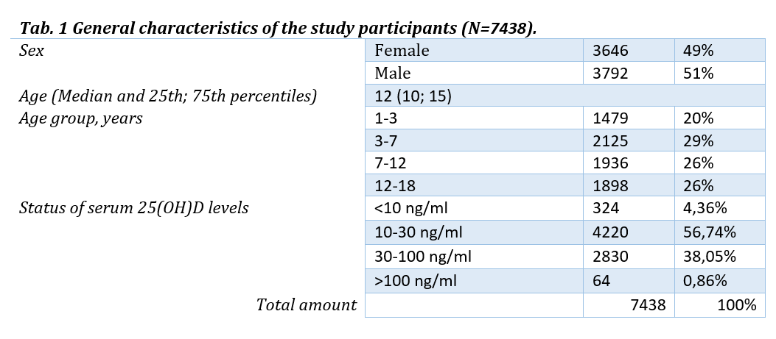
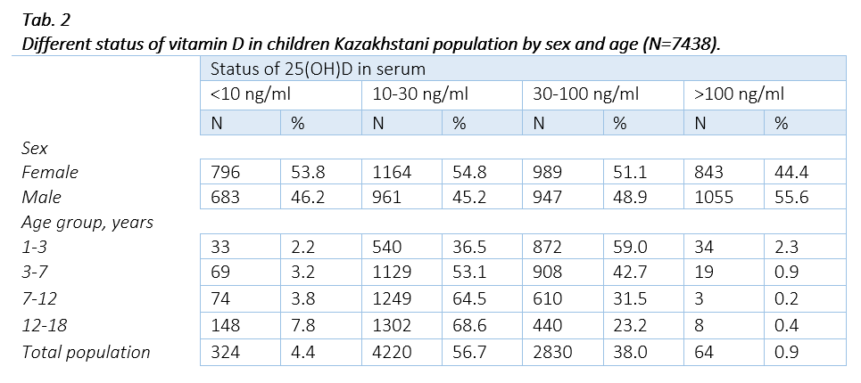
VITAMIN D DEFICIENCY IN ALMATY AND ALMATY REGION: CROSS-SECTIONAL STUDY
V. Khan¹, T. Nurpeissov¹, N. Tataurschikova²
¹Asfendiyarov Kazakh National Medical University, Almaty, Kazakhstan;
²Peoples' Friendship University of Russia, Moscow, Russia
Background
Relevance
Vitamin D insufficiency and deficiency is the modern and global problem of healthcare system around the world. Lots of studies have been conducted to prove a relationship between the lack of vitamin D production and physical health disorders. For example, vitamin D deficiency gives a negative influence on pathology of allergic diseases.
Despite of well-known dietary sources of vitamin D and sunlight presence in its production, most of the children living in Almaty region, Kazakhstan, may have not enough serum level of 25-hydroxyvitamin D, even if we pay attention to the fact, that children take vitamin D as a rickets vaccine, before they will turn 1 year of age.
Method
A cross sectional study was carried out in Almaty region from January to December 2022 among the children with age ranging from 1 to 18 years. Vitamin D deficiency was observed in patients with a level of 25(OH)D < 10 ng/ml, deficiency 10-30 ng/ml, normal values 30 -100 ng/ml.
Results
There are 7438 patients took a part in the study, aged 1-18 years, of both sexes, amid them 1479 aged 1-3 years, 2125 aged 3-7 years, 1936 aged 7-12 years and 1898 aged 12-18 years.
A main part of participants (56,74%) showed a vitamin D level in the range of 10-30 ng/ml and in a third of patients (38.05%) the vitamin D concentration was within the acceptable range. However, in 4.36% of patients, there was a quite noticeable deficiency of vitamin D, and in 0.86% the vitamin D level was above 100 ng/ml.
The median level of vitamin D in the study group was 25.9 ng/ml.
It’s worth noting that with the increase in the subjects’ age, the proportion of patients with vitamin D insufficiency and deficiency increases too. Thus, in the group of 1-3 years patients’ proportion with vitamin D insufficiency was 38,74%, in the group of 7-12 years old - 68.34%, and in the group of 12-18 years old - 76.40%, respectively.
Conclusion
At the end of study was found out that among the population of Almaty region in Kazakhstan, a big part of children have insufficient levels of vitamin D, despite the fact that this region is located in the southeastern part of Kazakhstan. We can also see an increasing tendency of patients with 25(OH)D insufficiency as they get an age. Perhaps a preventive measure such as rickets vaccine for children under 1-year-old could be a reason of this tendency.

